Slide 1

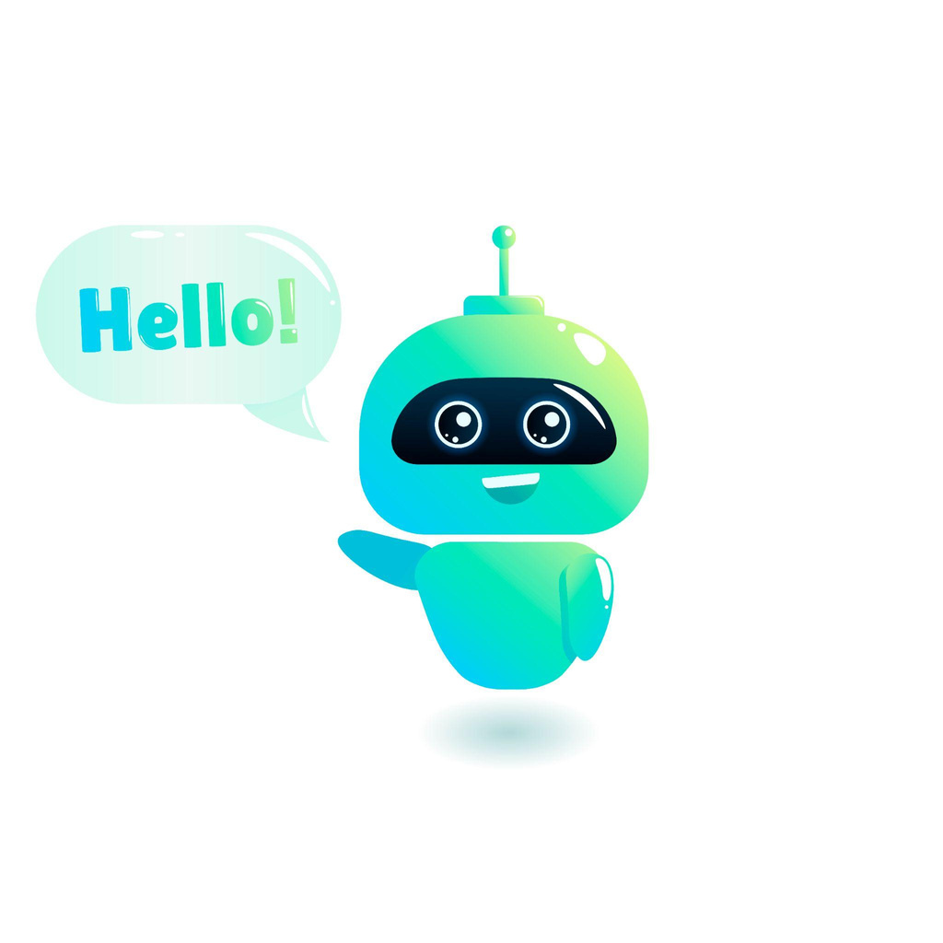
A Project Presentation for the Degree of Bachelor in Computer Engineering
Admission Enquiry Chatbot
Group Member Name
1) Anurag Kalbhor 3) Shreyash Jangam
2) Pranay Ushir 4) Umesh Patil
Under the Guidance of
Dr. Swati Nikam
Pimpri Chinchwad College Of Engineering & Research
A.Y 2024-2025

Slide 2
OUTLINE
Introduction
Challenges
Objective
Literature Survey
Problem Statement
Proposed System
Feasibility Study
Requirement Analysis
Advantages
Disadvantages
Flowchart
Use Case Diagram
Sequence Diagram
Scope and Feasibility
Output
Conclusion
IPR-Copyright
References

Slide 3
INTRODUCTION
In today's fast-paced digital world, providing quick and accurate information to prospective students is crucial for institutions. Traditional admission processes often involve lengthy communication cycles, which can create barriers for students seeking timely information.
Our project aims to bridge this gap with an AI-powered Admission Enquiry Chatbot that delivers instant, 24/7 responses to common admission-related queries. This chatbot not only enhances user experience but also automates repetitive tasks for admission teams, freeing up valuable resources.

Slide 4
CHALLENGES
Excessive Administrative Workload: Admission departments often face a high volume of repetitive queries, which limits their ability to focus on complex cases and strategic tasks.
Restricted Service Hours: Support services are typically available only during office hours, making it difficult for students in different time zones or with urgent needs to receive timely assistance.
Slow Response Times: Traditional admission systems can lead to significant delays in addressing student queries, resulting in confusion, frustration, and missed opportunities for applicants.

Slide 5
OBJECTIVES
To design a system that responds to student admission queries in real-time, reducing the need for physical visits or calls.
To eliminate manual dependency by providing an automated platform for handling frequent admission-related questions.
To provide prospective students with 24/7 access to accurate information regarding courses, fees, eligibility and scholarships.
Handle Complex Queries and Escalation
Provide Instant Access to Frequently Asked Questions (FAQs)

Slide 6
LITERATURE SURVEY
AUTHOR | TITLE | METHODOLOGY | RESULTS | FINDINGS
Gandhar Khandagale, Meghana Wagh, Pranali Patil, & Satish Kuchiwale[2023] | Intelligent Chatbot for College Enquiry System | Pattern Matching Algorithm, AIML, NLP, LSTM | Chatbot that provides real-time information on college admissions, fees, and scholarships through NLP and AI-based interaction | around 65% of common student inquiries were effectively handled by the chatbot
O. L. S. S. Kumari [2023] | AI-Based Student Enquiry System | AIML, Text-to-Speech, JSON Web Tokens | A chatbot integrated into a university website that automates answers to student queries 24/7, reducing helpdesk workload | reduced helpdesk queries by 60% and achieved 90% accuracy in responding to student queries

Slide 7
LITERATURE SURVEY
AUTHOR | TITLE | METHODOLOGY | RESULTS | FINDINGS
Jimoh K. O., Adebayo O. Y., Akinfenwa T. O., & Abimbola I. B. [2022] | Development of a Cloud-Based Student Information Chatbot System | AIML, Python, HTML, CSS, JavaScript, MySQL | A cloud-based chatbot that responds to student FAQs, improving accessibility and response time | chatbot resulted in a 50% decrease in the need for manual intervention by college staff for routine inquiries
Alaa Aloqayli & Hoda Abdelhafez [2022] | Intelligent Chatbot for Admission in Higher Education | AIML, Text-to-Speech, JSON Web Tokens | Botsify platform, CUQ, Confusion Matrix | chatbot could answer 80% of admission-related questions accurately and reducing the overall time for handling inquiries by 40% during peak admission periods

Slide 8
LITERATURE SURVEY
AUTHOR | TITLE | METHODOLOGY | RESULTS | FINDINGS
Julius Odede & Ingo Frommholz [2021] | Admission with an LLM-based Chatbot | Large Language Models (LLMs) | LLM-based chatbot for university admission assistance | By leveraging LLM technology for achieving a response accuracy rate of 92%.
Jooka: A Bilingual Chatbot for University Admission [2021] | Walid El Hefny, Yasmin Mansy, Mina Abdallah, and Slim Abdennadher | Jooka, a bilingual chatbot for university admissions, used Dialogflow ES for intent matching and Google Cloud Translation API | Evaluated by 27 participants (85.2% high school students), Jooka achieved average SUS and CUQ scores of 88.5 and 87.3 | 80%+ satisfaction with bilingual support and ease of use.

Slide 9
PROBLEM STATEMENT
This project aims to create a Admission Enquiry Chatbot to address repetitive admission inquiries that cause delays. The chatbot will provide real-time answers to common questions about courses, eligibility, fees, deadlines and application procedures, while escalating complex queries to staff. This will improve efficiency and user experience.

Slide 10
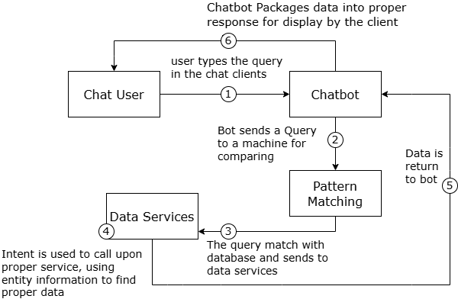
Proposed SYSTEM

Slide 11
FEASIBILITY STUDY
Software feasibility
Frontend
HTML
CSS
Javascript
Bootstrap
Backend
Python
Flask
Model
Gemini 1.5 Flash (pre-trained)
Hardware feasibility
CPU Speed : 2GHz
RAM : 8GB
Hard Disk : 1TB
Operational Feasibility
Ease of use for students and staff
24/7 availability for admission queries
Ability to handle repetitive FAQs automatically
Reduces manual workload for administrative staff

Slide 12



REQUIREMENT ANALYSIS
Python Flask for developing the backend and managing API communication between the user interface and the chatbot engine.
HTML, CSS, JavaScript for building a responsive and interactive user interface to facilitate student interaction.
Gemini 1.5 Flash Pre-trained Model for intelligent query processing and generating accurate responses from the admission dataset.
CSV/JSON Dataset Integration for storing institutional FAQs, course details, and admission-related information.
Flask Routing and Templating to connect the UI components with chatbot logic and dynamically display responses.

Slide 13
Advantages
Efficiency: Automates responses to common inquiries, reducing the workload on staff.
24/7 Availability: Provides instant support to prospective students at any time.
Consistency: Ensures uniformity in responses, minimizing human error.
Scalability: Easily handles a high volume of inquiries without additional resources.
Improved User Experience: Offers quick access to information, enhancing user satisfaction

Slide 14
Disadvantages
Limited Understanding: May struggle with complex or nuanced queries that require human judgment.
Initial Setup Costs: Development and implementation may require significant time and resources.
Maintenance: Regular updates and maintenance are needed to keep information accurate and relevant.
User Frustration: Users may become frustrated if their questions are not adequately addressed

Slide 15
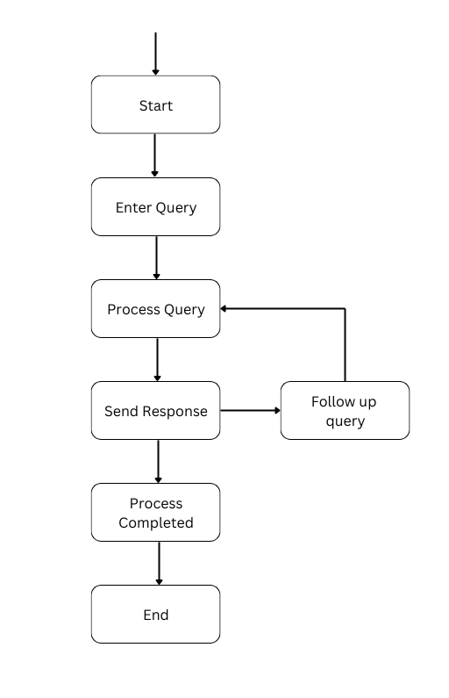
Flowchart

Slide 16
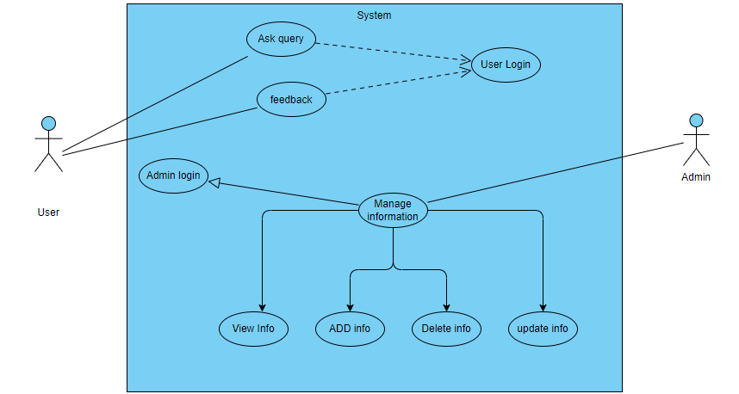
USE CASE

Slide 17
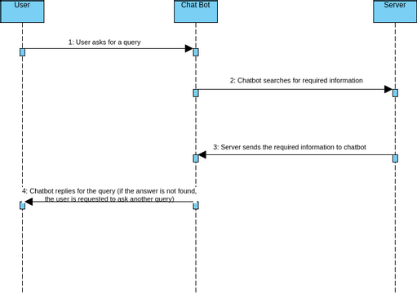
SEQUENCE DIAGRAM

Slide 18
SCOPE AND FEASIBILTIY
24/7 Assistance: Provides round-the-clock support for prospective students regarding admission queries.
Multi-platform Availability: Accessible via website, mobile app, and social media platforms.
Personalized Responses: Tailored replies based on user-specific queries like eligibility, courses, and deadlines.
.

Slide 19
SCOPE AND FEASIBILTIY
Scalability: Can handle increasing volumes of inquiries without impacting response time or quality.

Slide 20
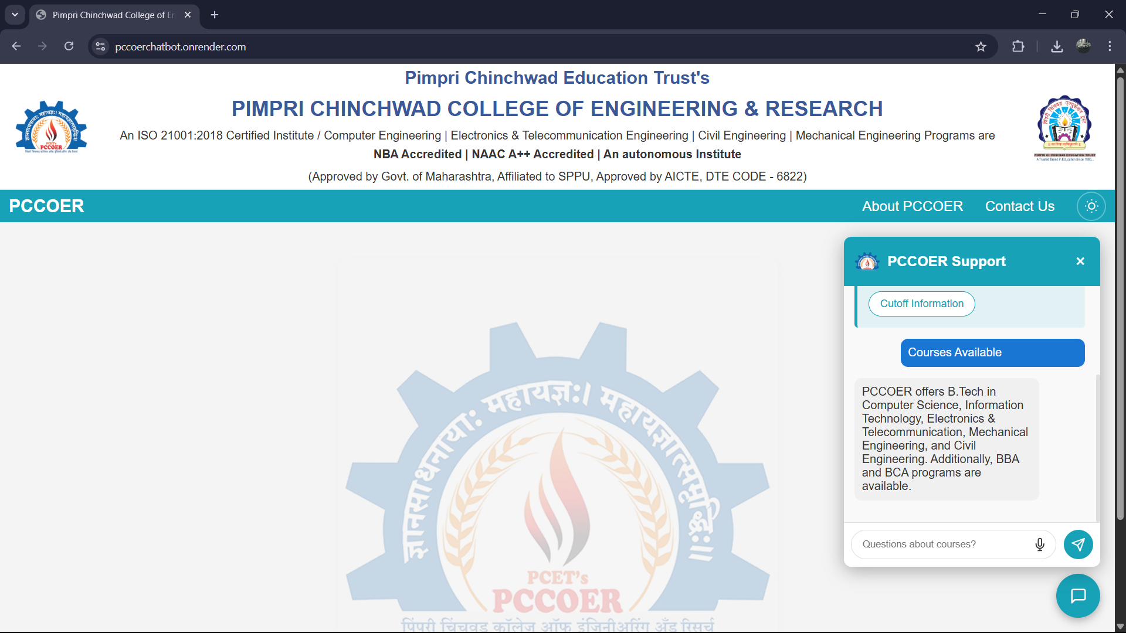
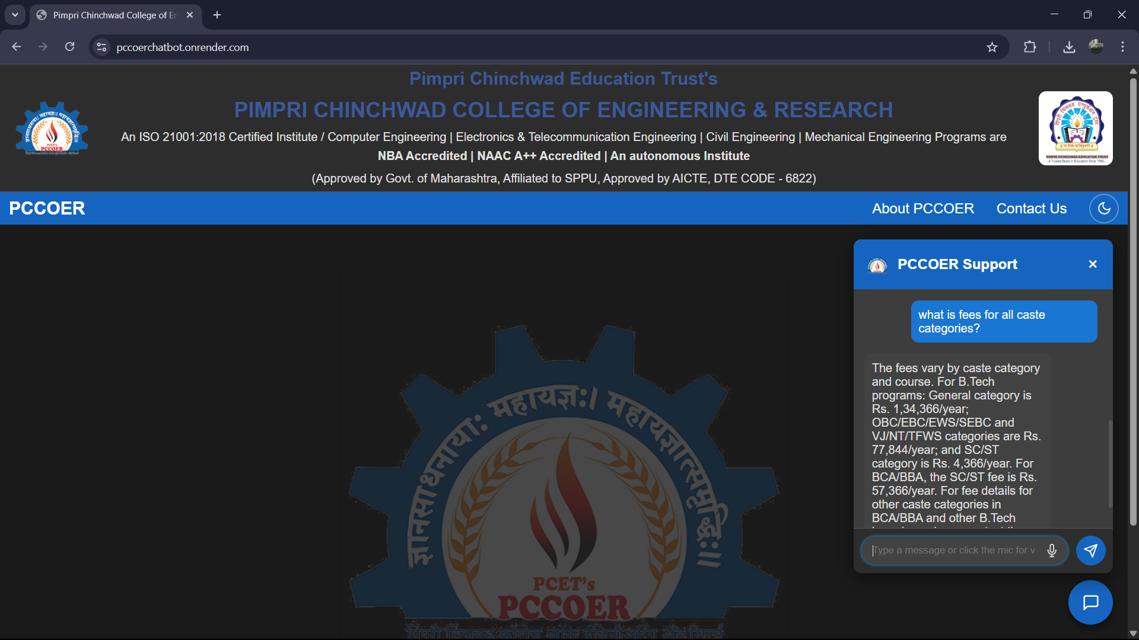
OUTPUT

Slide 21
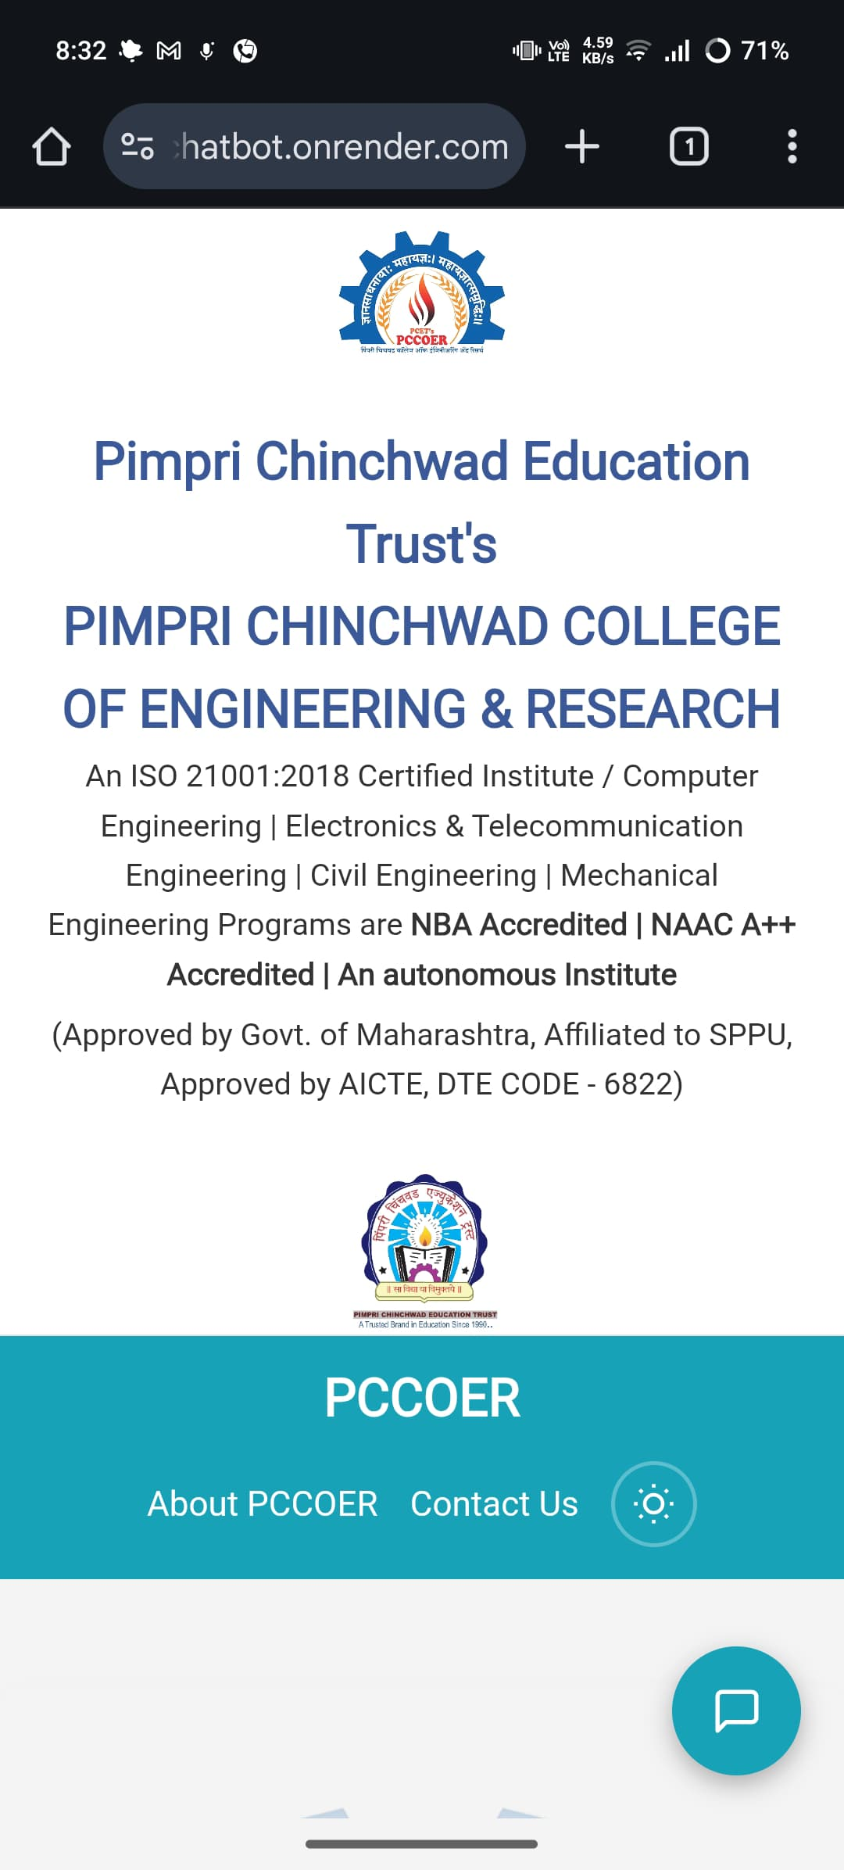
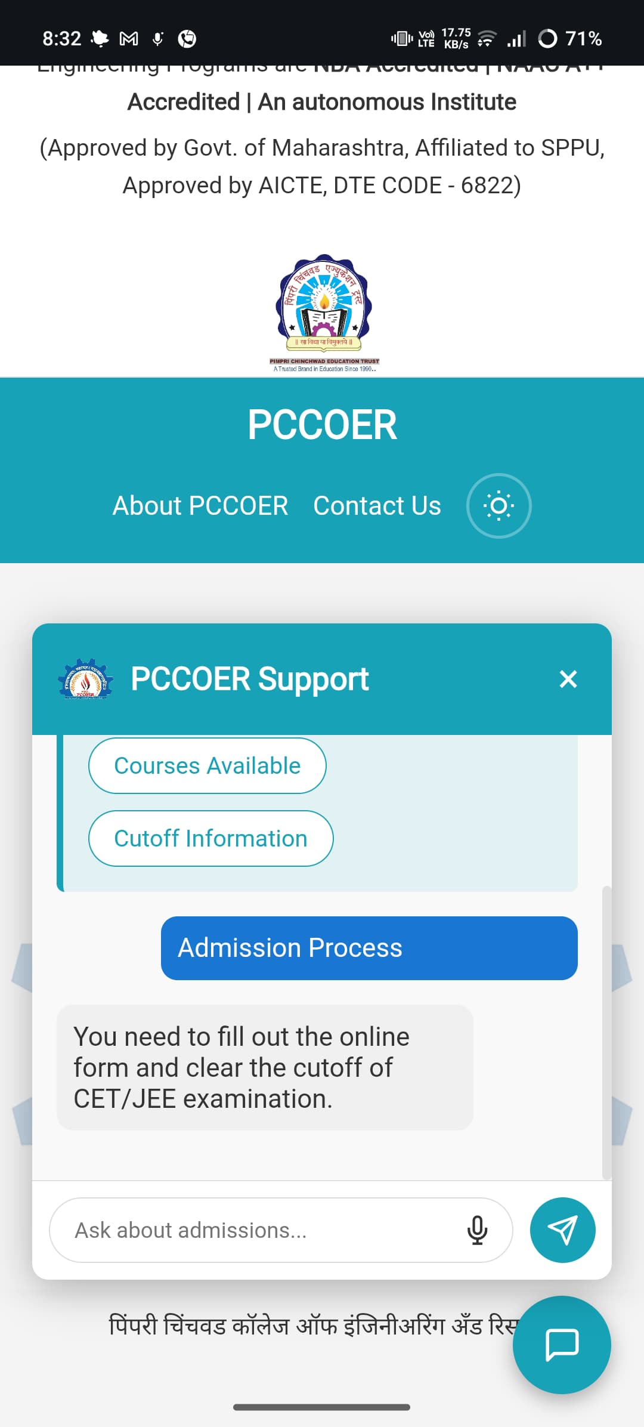
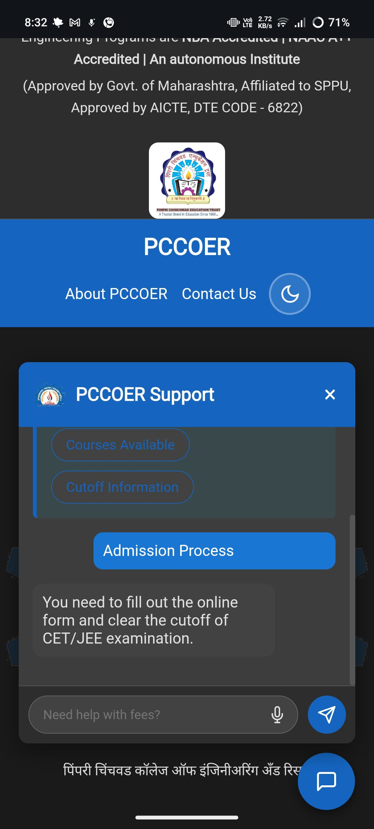
OUTPUT

Slide 22
RESULT ANALYSIS
The chatbot effectively handles admission-related queries like course details, eligibility, and contact information.
Integrated with a custom dataset, ensuring institution-specific responses.
Achieved accuracy over 95% during testing on 50+ queries.
Average response time recorded: 2-3 seconds, ensuring near-instant replies.
Successfully deployed with a user-friendly interface (HTML/CSS/JavaScript).
Can reduce repetitive manual workload of admission queries by over 70%.

Slide 23
CONCLUSION
In conclusion, the admission inquiry chatbot significantly enhances the efficiency of the admission process by automating repetitive tasks, allowing staff to focus on more complex queries. It offers prospective students a seamless and engaging user experience with instant, 24/7 access to accurate information, improving satisfaction and communication. The solution is highly scalable, capable of handling a growing volume of inquiries without compromising response quality.

Slide 24
PUBLICATIONS/IPR - COPYRIGHT
Paper Published: Successfully published our research paper on the Admission Enquiry Chatbot at ICETC 2025 (International Conference on Emerging Technologies in Computing).
IPR – Copyright Secured: We have officially obtained IPR-Copyright for our chatbot system titled "Admission Enquiry Chatbot" ensuring legal protection and innovation recognition.
Paper Submission: Our paper has also been submitted to ICCUBAE 2025 (International Conference on Contemporary Urban, Business, Architecture, and Engineering). Awaiting acceptance confirmation

Slide 25
References
Jimoh K. O., Adebayo O. Y., Akinfenwa T. O., & Abimbola I. B. (2022). Development of a Cloud-Based Student Information Chatbot System. International Journal of Computer Applications, 182(14), 1-8.
Alaa Aloqayli, & Hoda Abdelhafez. (2023). Intelligent Chatbot for Admission in Higher Education. Journal of King Saud University - Computer and Information Sciences. DOI: 10.1016/j.jksuci.2023.01.003.
Gandhar Khandagale, Meghana Wagh, Pranali Patil, & Satish Kuchiwale. (2022). Intelligent Chatbot for College Enquiry System. International Journal of Engineering Research & Technology, 11(6), 183-187.
O. L. S. S. Kumari. (2020). AI-Based Student Enquiry System. International Journal of Innovative Technology and Exploring Engineering, 9(3), 2305-2308.

Slide 26
References
FrommholzI.Odede, J. Jaybot: Aiding university students and admission with an llm-based chatbot. ACM Transactions on Computing Education (TOCE), 23(2), 1-25. DOI: 10.1145/3560317, 2024.
El Hefny, W., Mansy, Y., Abdallah, M., & Abdennadher, S. (2021). Jooka: A Bilingual Chatbot for University Admission. Springer International Publishing, 72660(7), 1-12. DOI: 10.1007/978-3-030-72660-7_64.

Slide 27
THANK YOU!

